Slide 1
Policies and Strategies to Enhance The Quality Of Early Childhood and Primary Education in Indonesia
Hamid Muhammad, Ph.D
DIRECTOR GENERAL OF PRIMARY AND SECONDARY EDUCATION
1st International Conference on Early Childhood and Primary Education
Malang, East Java September 21^{st 2018}
MINISTRY OF EDUCATION AND CULTURE
REPUBLIC OF INDONESIA

Slide 2
Indonesian Educational System

Slide 3
CHALLENGES
Industry Revolution
Fast Improvement
Super technology that could change conventional activities
job destruction (work that replaced the machine/robot)
B. Globalisation
The decree of the presence of foreign school for early childhood education
Western cultures are more trustworthy;
early childhood education n and primary education gap service is getting wide based socioeconomic disparities

Slide 4
CHALLENGES
C. Children born in 2010 are, including Alpha, with criteria:
There will be lots of birth that which will make a tight competition between others,
Addicted to technology,
Education level will be higher so an early good preparation for pre school education is important as a Z and Alpha
generation

Slide 5
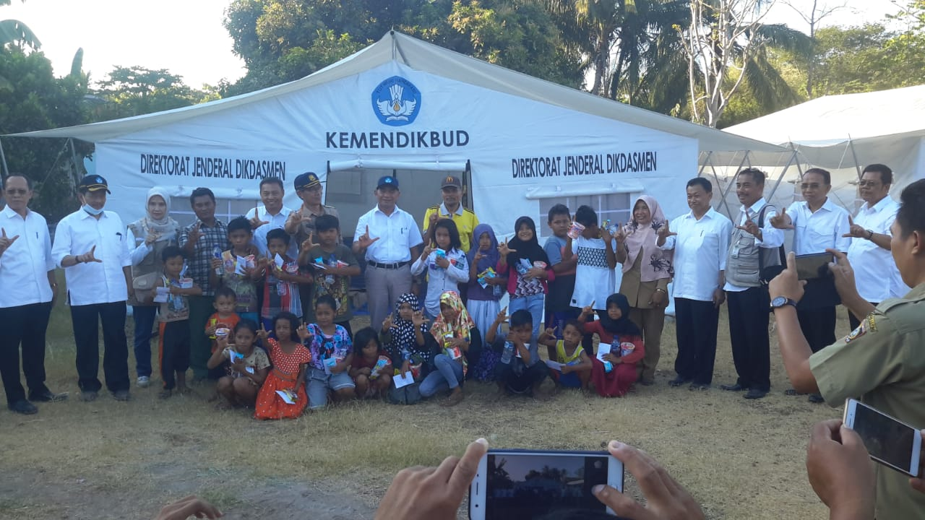
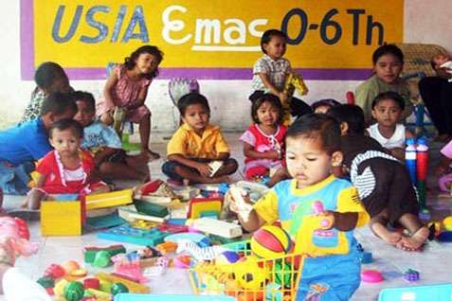
ECEDECED PROFILE

Slide 6
ECED Participation Age 0-6

Slide 7
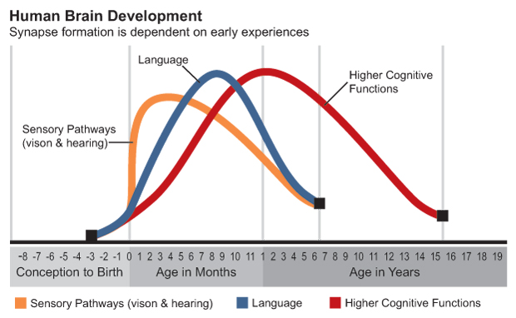
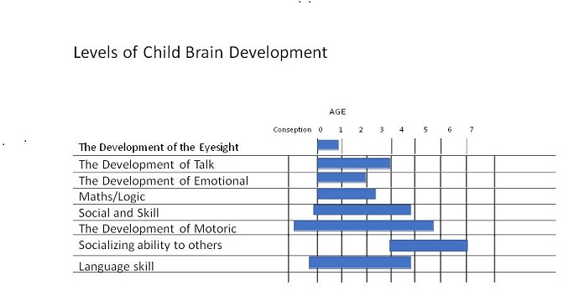
How Important Pre School Quality
Neurosains:
The fastest period of brain development occurs in the first phase of life ; the good quality of brain development could be last for a long time.

Slide 8
THE IMPORTANCE OF QUALITY IN ECED
Quality of early childhood development heavily influences health, economic and social outcomes for individuals and society at large
There are great economic gains to be had by investing in early childhood development

Slide 9
Policy of ECED
Access expansion and strengthening the Pre School Program and community on target, process, and study achievement
1
Preserving the region free of corruption and constantly improve governance accountable and transparent
Strengthen the quality of early childhood Education unit and community which is accredited, independent and competitiveness
5
Policy of Director General of Pre School Education and Community 2018
2
4
3
Enhancing the cooperation to the Central Government, regions and stakeholders in determining the ecosystem for early childhood education and community
Modernize and learning innovation of early childhood education and community in accordance with the era, science and technology and local wisdom

Slide 10
GOVERNMENT ROLES AND RESPONSIBILITIES

Slide 11
Access Expansion and Strengthening The Quality of ECED
Collaboration with relevant Ministry, to:
Build an Infrastructure Pre School
Provision toys for Pre School students
Improved quality by doing training for Pre School teacher
Pre School Teacher Transportation.
There are 9682 Early childhood Institutions in 2697 Villages were assisted by Village Fund

Slide 12
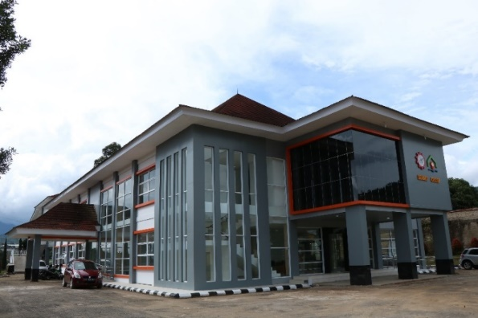
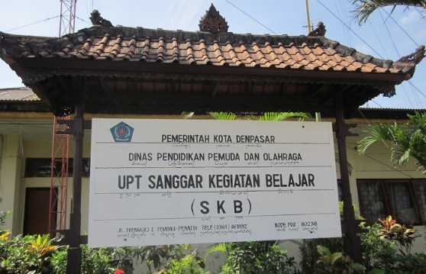
Strengthening of Institutional and Educational Units
The establishment of SEAMEO CECCEP: Center for the study and advocacy of early childhood education and Family Education in Southeast Asia
Development cooperation programmes with
More than 21 Centres
372 SKB have changed functions become units of the Non Formal Education
SEAMOLEC
RECFON
SEAQIS
SEAQIM
BIOTROP

Slide 13
Target Achievement of Quality Development
> 30.000
Educational unit
> 10.000
Educational unit
2018
2019
2016
2017
2015
> 40.000
Educational unit
> 20.000
Educational unit
6.000
Educational unit
Target of Strategic Plan 2017
PAUD : 5.759 lnstitutions
LKP : 3.500 institutions
PKBM : 995 institutions
It required the local government support in the budget and cooperation in doing guidance to achieve the national standards of education

Slide 14
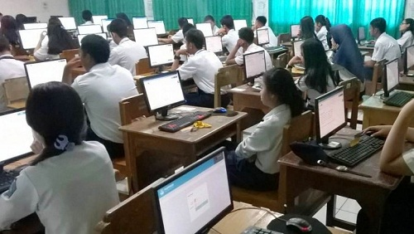
BASIC EDUCATION PRIMARY AND SECONDARY EDUCATION

Slide 15
Profile of Basic Education
Year 2018
Source: Center for Educational Data and Statistics and Culture, MOEC

Slide 16
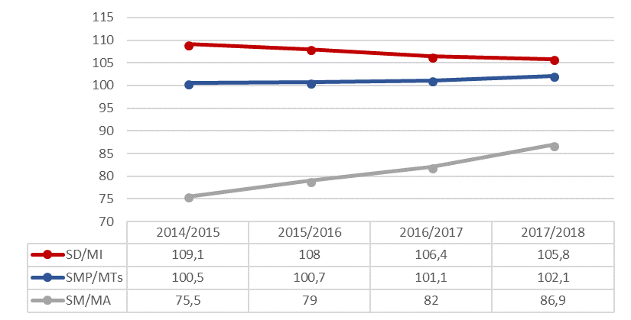
Gross Enrolment Ratio 2014 - 2017

Slide 18
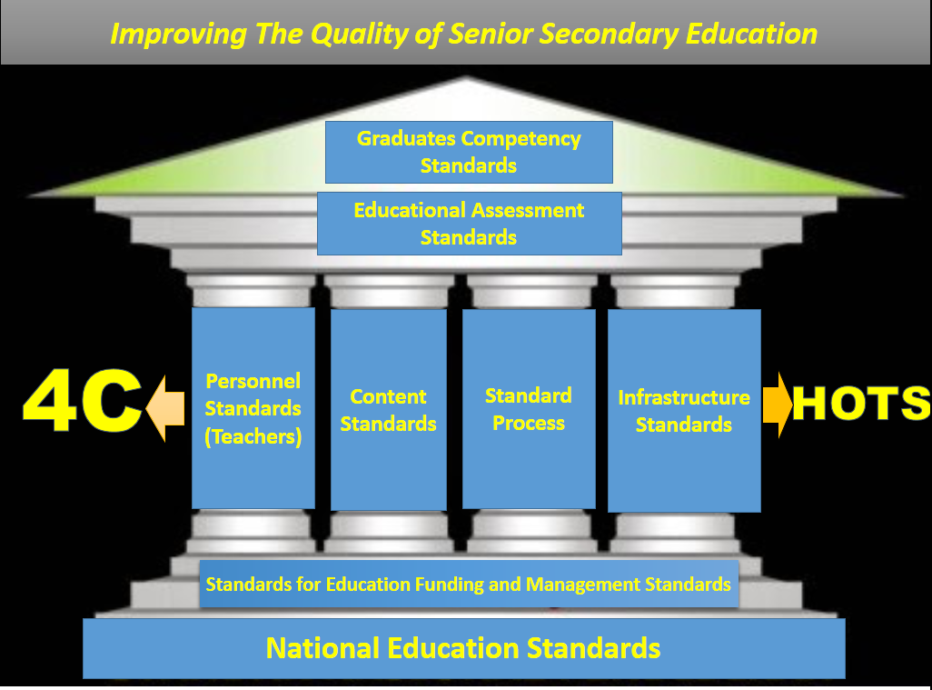
Improving The Quality of Basic Education

Slide 20
Character
Religious
Nationalism
Integrity
Collaboration
independent
Literacy
language and literature
Numeracy
Science
Financial
Culture and citizenship
Competencies
Crithical thinking
Creativity
Communication
collaboration

Slide 21
Character Building Reinforcement and
Literacy Activities
INTRA
CO & EXTRA CURRICULAR

Slide 22
Thank You

