Slide 1
Finland’s Policies
and
Innovation Pedagogy
in Improving the Quality of Education
Harri Lappalainen
Turku University of Applied Sciences, Finland
Malang, September 2018

Slide 2
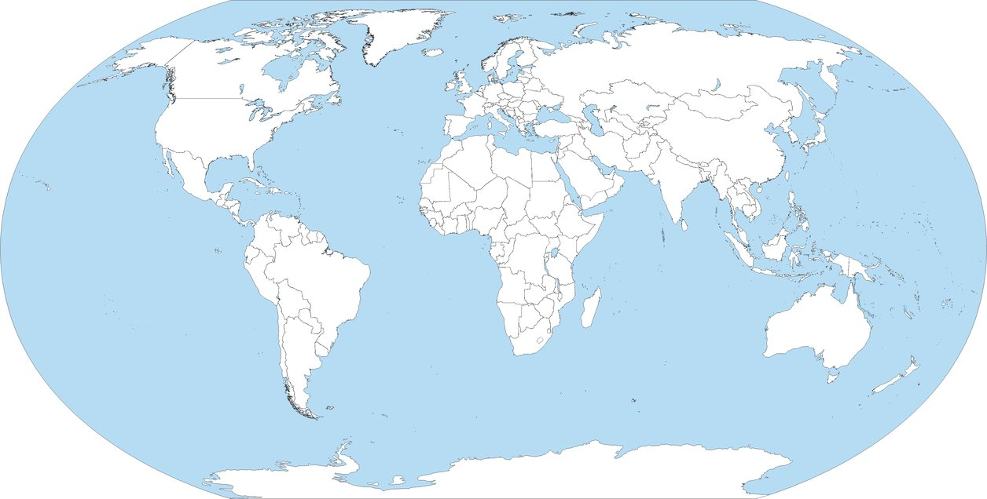
Greetings from Finland

Slide 3
Greetings from Finland

Slide 4
Greetings from Finland

Slide 5
Greetings from Finland
Around 11 000 km

Slide 6
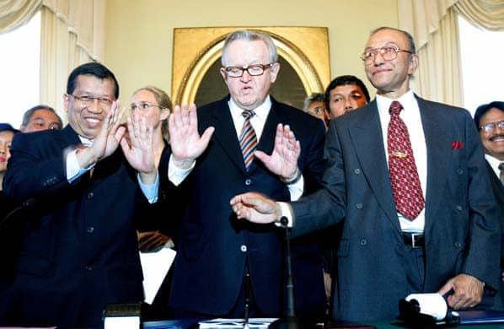
Martti Ahtisaari

Slide 7
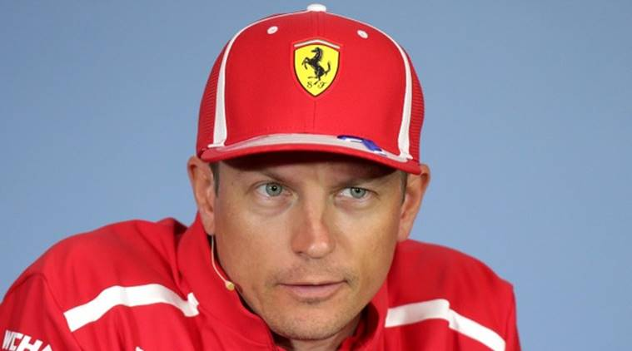
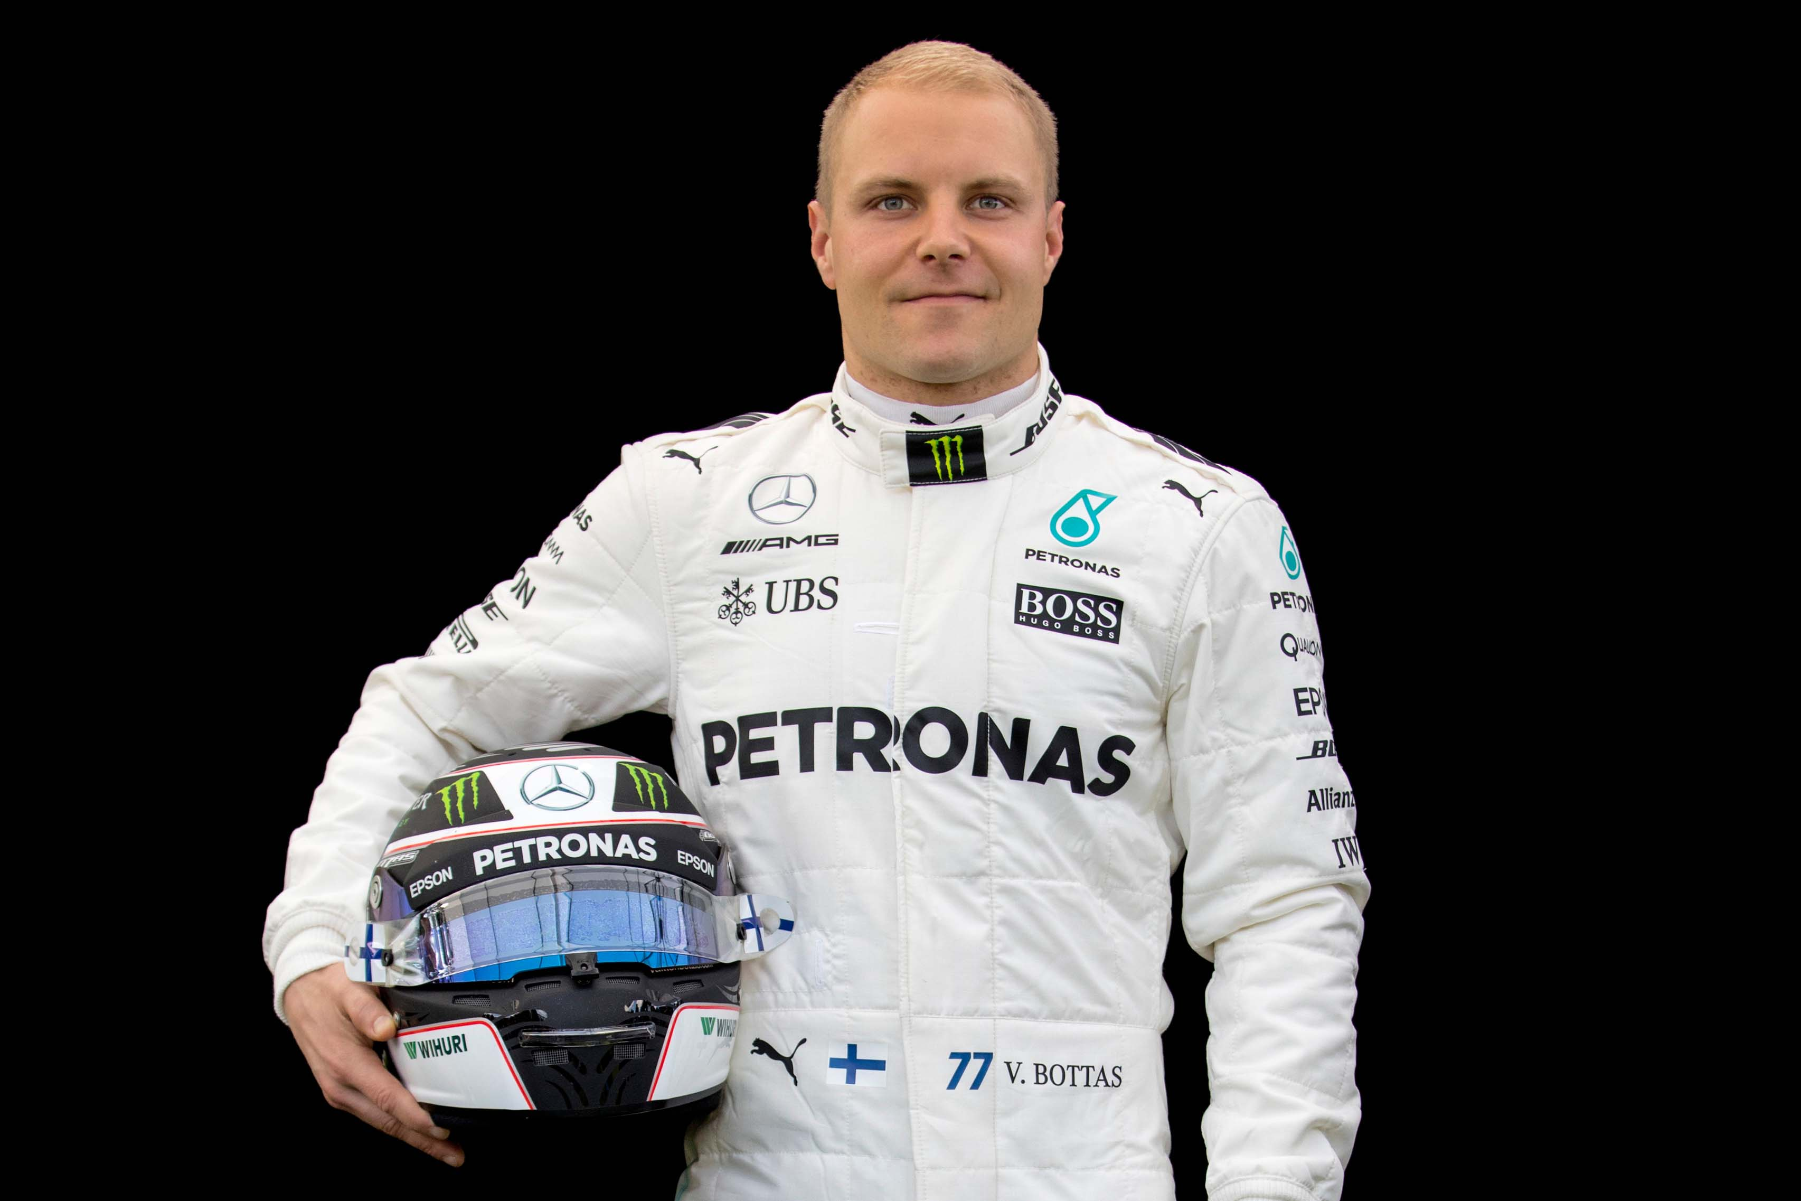
Kimi Räikkönen
Ferrari
Valtteri Bottas
Mercedes

Slide 9
IS OUR EDUCATION
SYSTEM PRODUCING SKILLS, COMPETENCES AND ATTITUDES THAT REALLY MATTER IN THE FUTURE?

Slide 10
Complex Problem Solving
Critical Thinking
Creativity
People Management
Coordinating with Others
Emotional Intelligence
Judgment and Decision Making
Service Orientation
Negotiation
Cognitive Flexibility
Future of jobs
Top 10 skills at 2020
Source: World Economic Forum (2016)

Slide 11
What makes Finnish education system unique?

Slide 12
Special characteristics of
Finnish primary education
Equality
Public schools
Free for all pupils
Narrowest achievement gap in the world
Between pupils
Between schools
Finnish teachers
High status profession, well paid
Lots of applicants to become a teacher candidate
Autonomy of schools and teachers
No standardized testing (only one in 12 years)

Slide 13
New Finnish national
core curriculum for basic education 2014
“Curriculum reform is intended to ensure that the knowledge and skills of Finnish children and youths will remain strong in the future, both nationally and internationally. In addition, pedagogical guidelines are defined to help schools develop their operating methods in order to increase the pupils' interest in and motivation for learning.”

Slide 14
5 cornerstones in new Finnish national core curriculum for basic education 2014
Renewing subjects
more optionality; social studies and 2nd language earlier
Transversal competences as part of every subject
e.g. communication, ICT, entrepreneurship, creativity
Changing the ways schools operate
e.g. school as a learning community, diversity of languages
At least one multidisciplinary learning module a year
project-based learning in teams, cooperation of teachers
Diversity in pupil assessment
formative assessment, several assessment methods

Slide 15
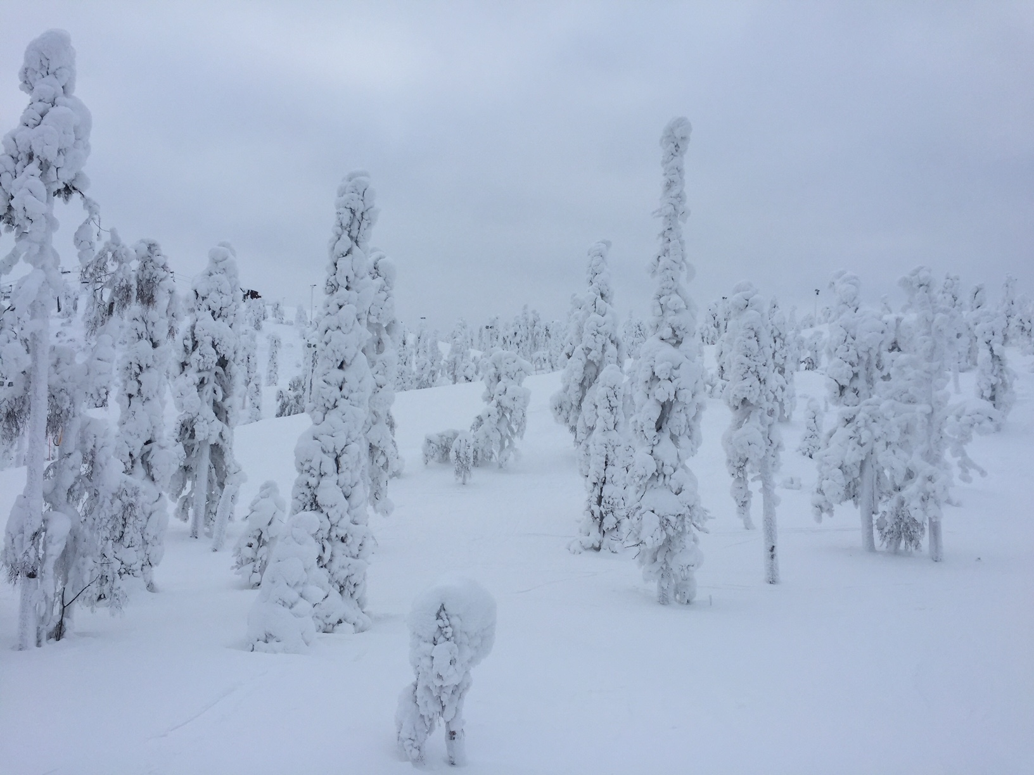

Slide 16
Finland is the happiest* country in the world
*World Happiness Report, UN, 2018
www.tuas.fi

Slide 17
WHAT KIND OF COMPETENCES ARE NEEDED FOR
INNOVATION
PROCESSES?

Slide 18
Innovation
Initiative
Teamwork
Creativity
Networking
Critical Thinking
Competence
© FINCODA UPV-SEE-CSP team (2017). Innovation Competence Model

Slide 19
ARE WE ABLE TO ASSESS INNOVATION COMPETENCES?

Slide 20
http://edu.docdat.com/tw_files2/urls_11/371/d-370082/img3.jpg

Slide 21
FINCODA Rater Training Toolkit
FINCODA Barometer
www.fincoda.eu
FINCODA – Framework for Innovation Competences Development and Assessment

Slide 22
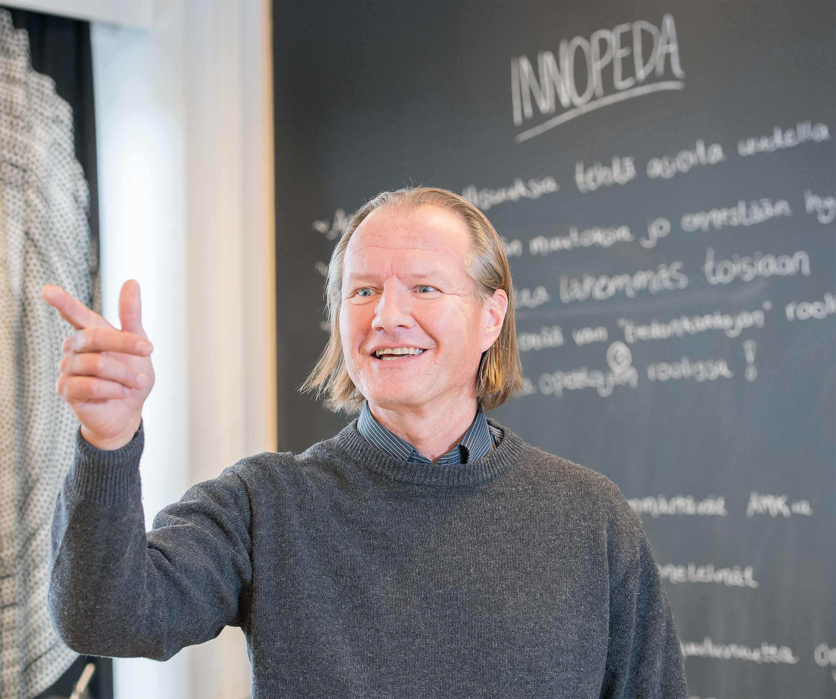
Harri Lappalainen
Turku University of Applied Sciences, Finland
harri.lappalainen@turkuamk.fi
www.indoped.eu
www.fincoda.eu

